Slide 1
Eberhard O. Voit
A First Course in
Systems Biology
Chapter 5
Parameter Estimation
Copyright © Garland Science 2013

Slide 2
Parameter Estimation
Parameter estimation refers to the process of using sample data (in reliability engineering, usually times-to-failure or success data) to estimate the parameters of the selected distribution.

Slide 3
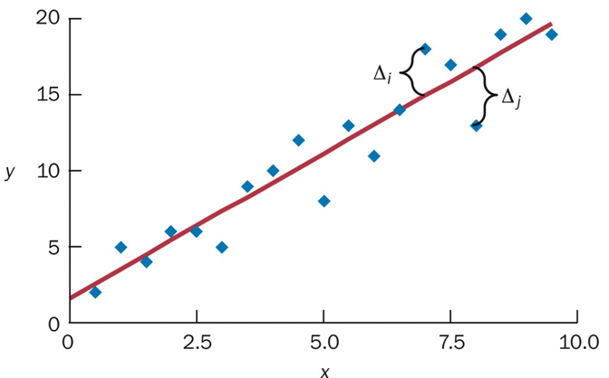
Linear regression
Regression analysis is a set of statistical processes for estimating the relationships among variables.
Linear regression is a linear approach for modeling the relationship between a scalar dependent variable y and one or more independent variables denoted x.
y = 1.89x + 1.63
Minimize sum of squared errors (SSE) through least-square methods.

Slide 4
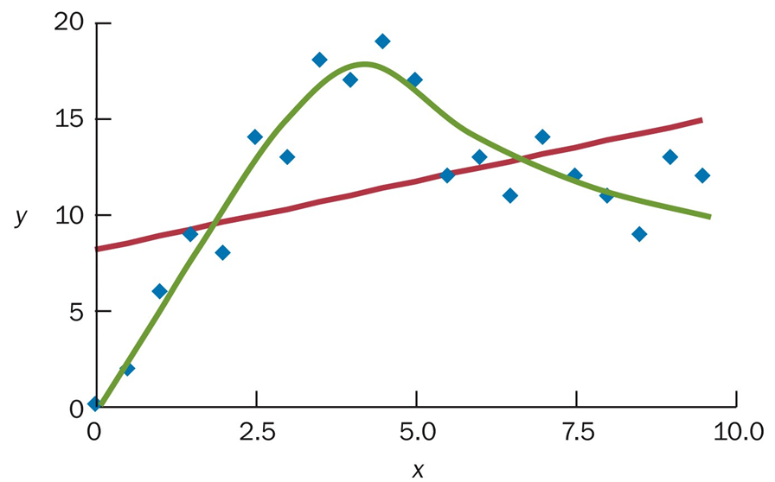
Correct use vs Wrong use

Slide 5
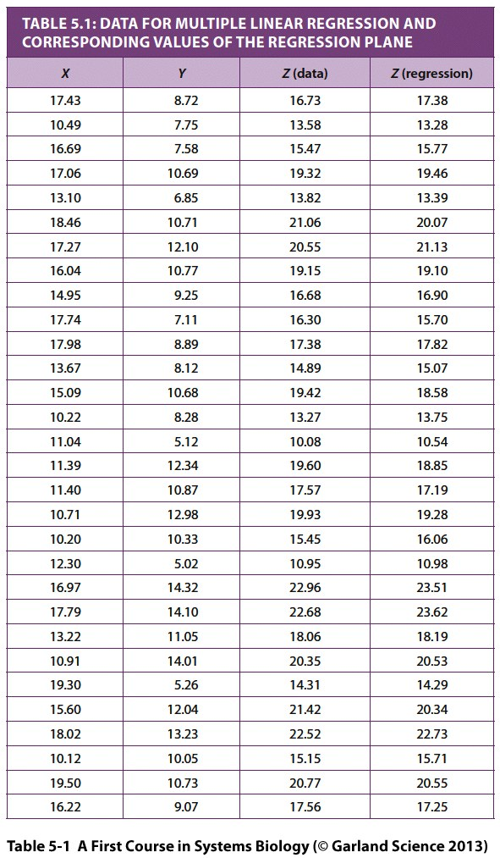
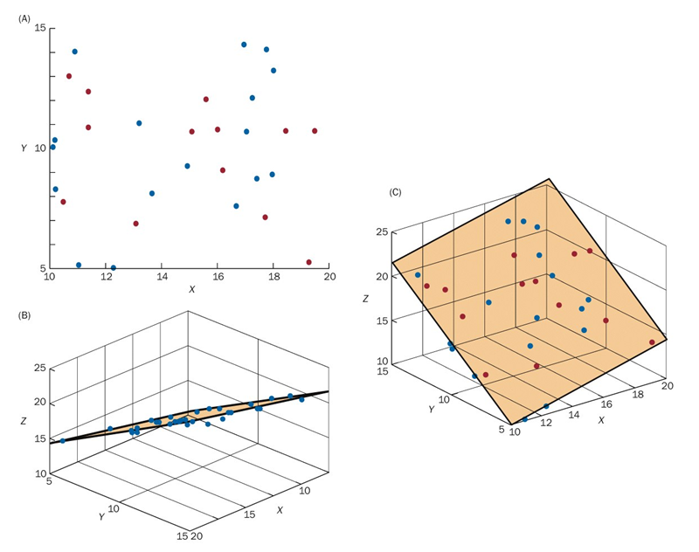
Linear regression with two variables

Slide 6
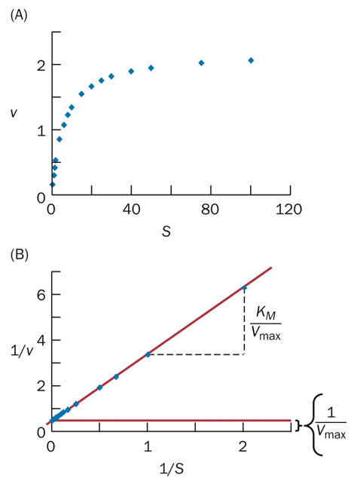
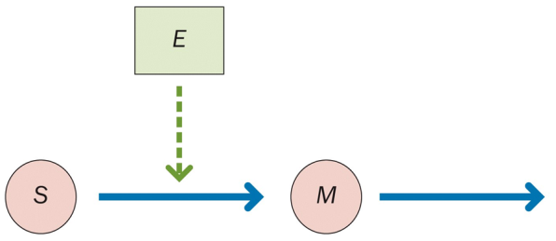
Michaelis-Menten equation
dM = V_{max} S - cM
dt K_{M} +S
K_{M} and V_{max} can be estimated using linear
regression

Slide 7
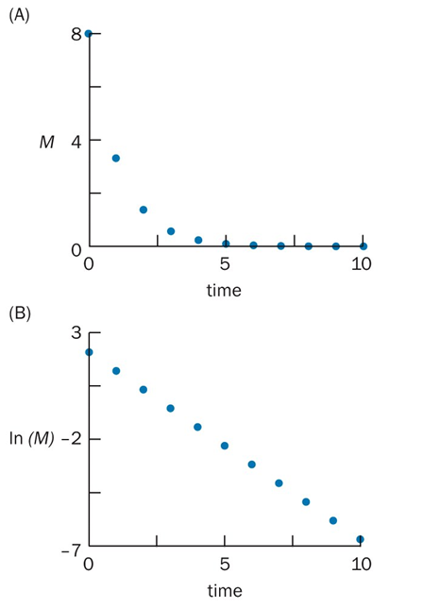
Michaelis-Menten equation
dM = V_{max} S - cM
dt K_{M} +S
c can be estimated using separate experiment

Slide 8
Parameter estimation in non-linear systems
Three classes of search algorithms:
Exhaustive search
Gradient search (steepest descent/hill-climb)
Evolutionary algorithms

Slide 9
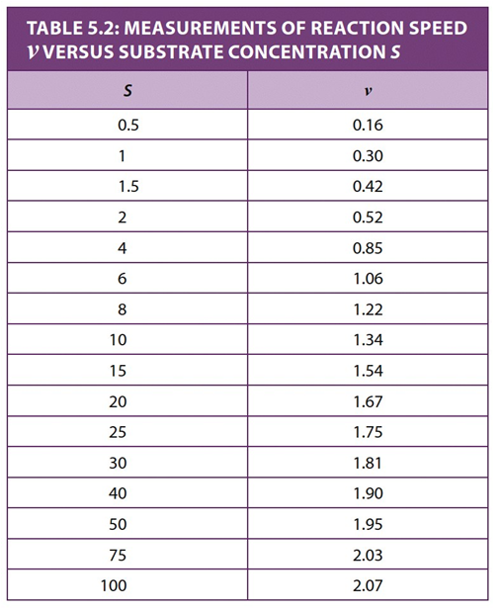
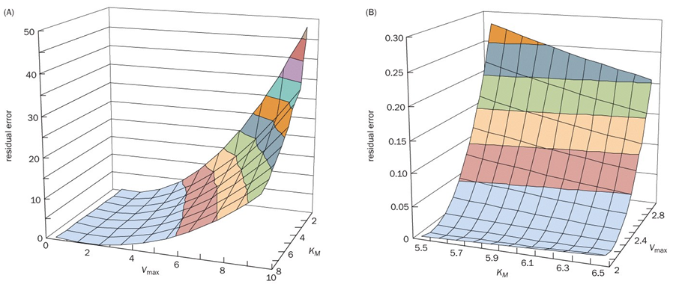
Comprehensive grid search
Residual errors (SSEs) in a grid search
Heavy computation is a serious problem for finer search. Sophesticated approaches such as Latin hypercube sampling and branch-and-bound methods could be useful.

Slide 10
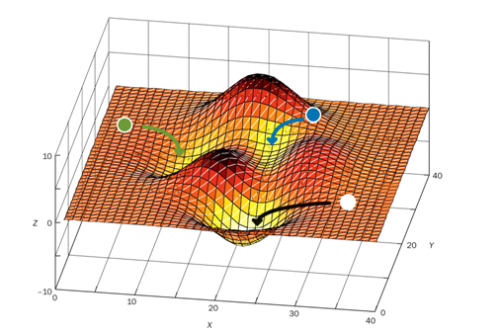
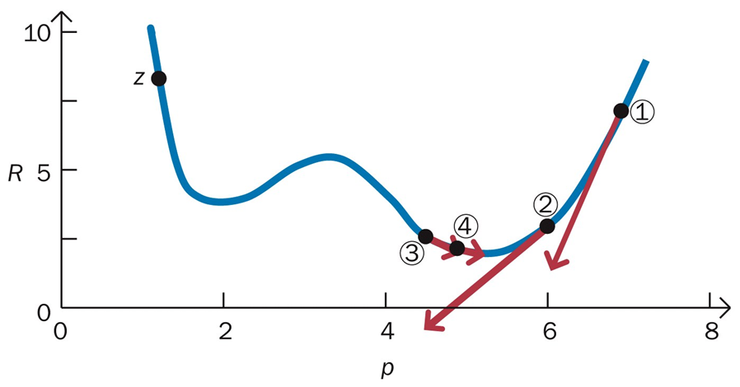
Non-linear regression

Slide 11
Genetic Algorithm

Slide 12
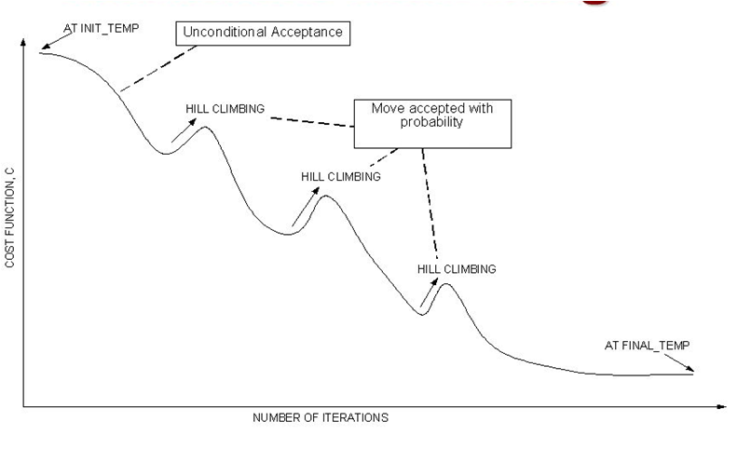
Other Stochastic Algorithms
Simulated Annealing

Slide 14
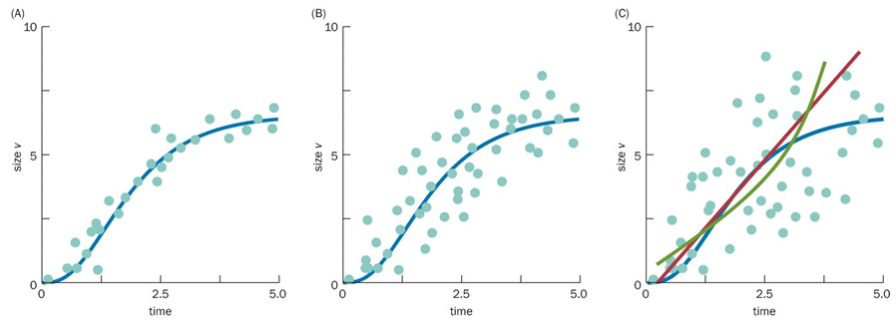
Challenges:
1. Noise

Slide 15
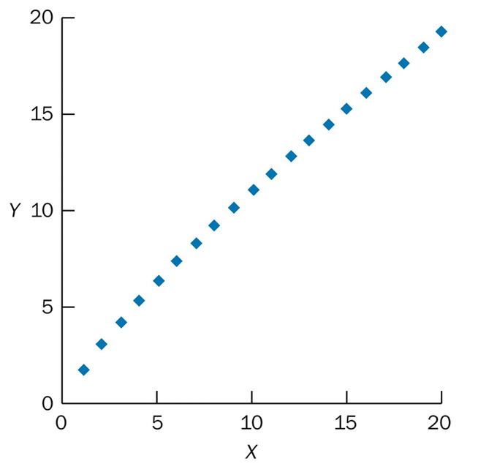
Challenges:
2. Multiple solutions for same SSE
Example 1:
p₁p₂ = 12 with p₁ = 3, p₂ = 4
Example 2:
Consider f = pXªY^{b}
If Y = αX^{γ} , then the following two solutions give
identical results with α = 1.75 and γ = 0.8:
(2.45, 1.2, -0.3) and (4.2875, 2, -1.3)

Slide 16
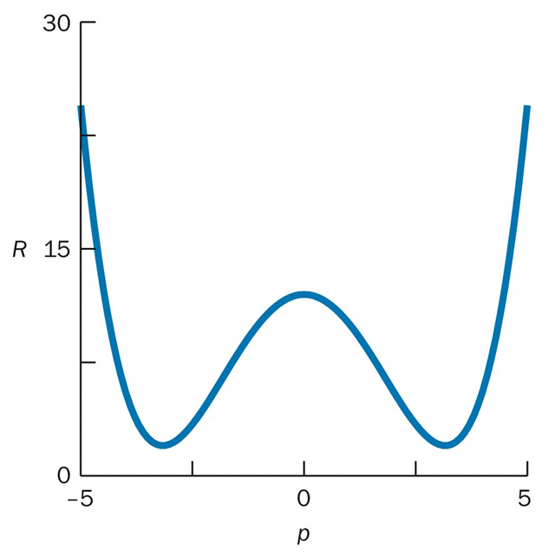
Challenges:
3. Sloppiness

Slide 17
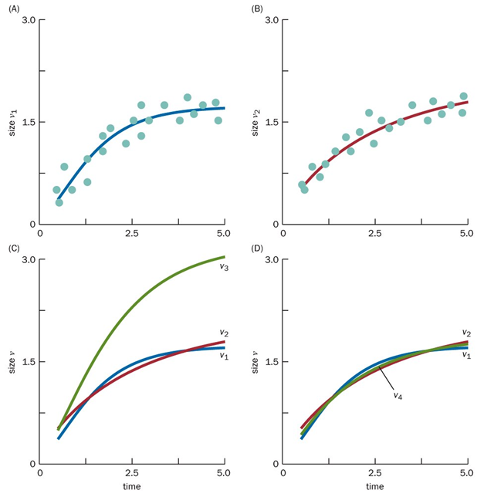
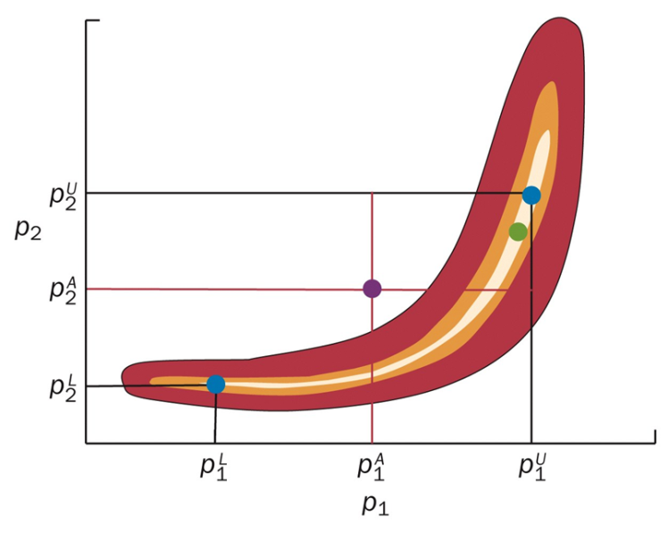

Slide 18
Parameter Estimation for Systems of Differential Equations
Main reasons for the estimation is harder:
Usually contain more parameters than individual functions
Necessity for comparing time-dependent experimental data with solutions of differential equations, requiring lot of computation.

Slide 19
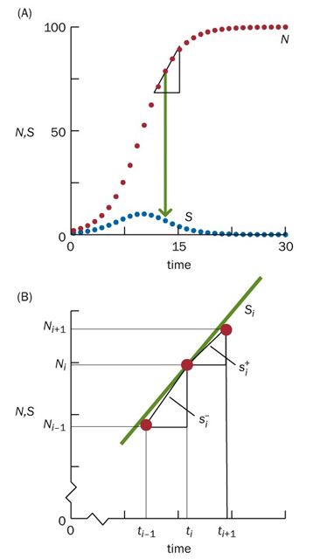
Parameter Estimation for Systems of Differential Equations
One solution: Avoid computation (related to integration)!

Slide 20
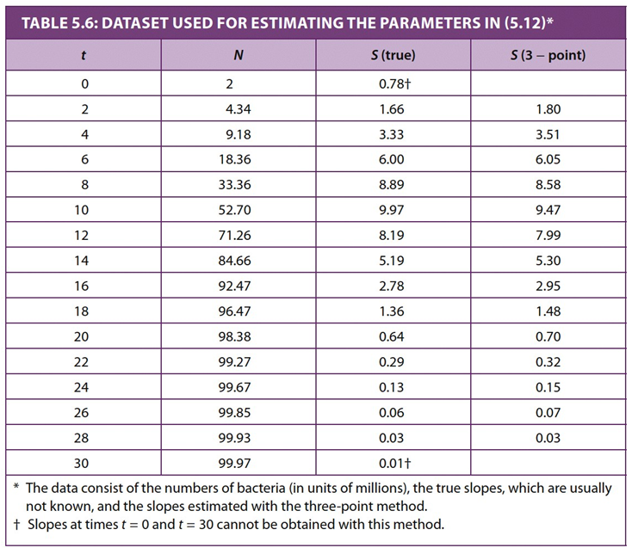
1.80 = 4.34a – 4.34b²
3.51 = 9.18a – 9.18b²
a = 0.3899 (~ a = 0.4)
b = 0.0039 (~ b = 0.004)

