Slide 1
Eberhard O. Voit
A First Course in
Systems Biology
Chapter 3
Static Network Models

Slide 3
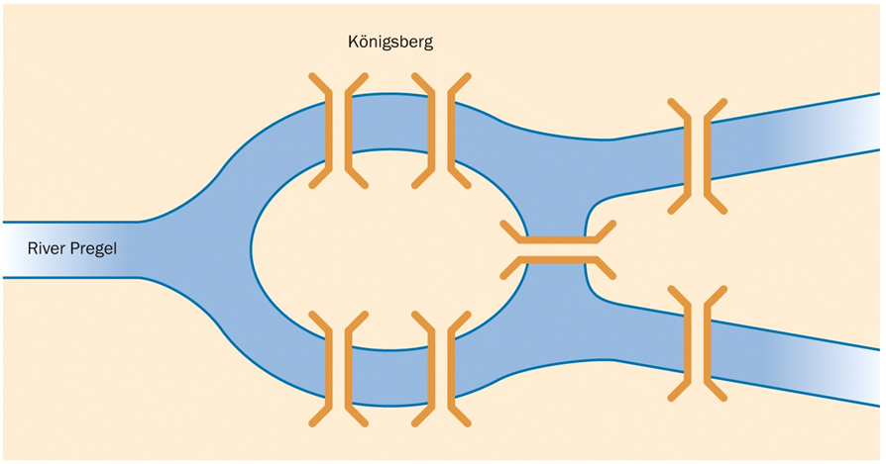

Slide 4
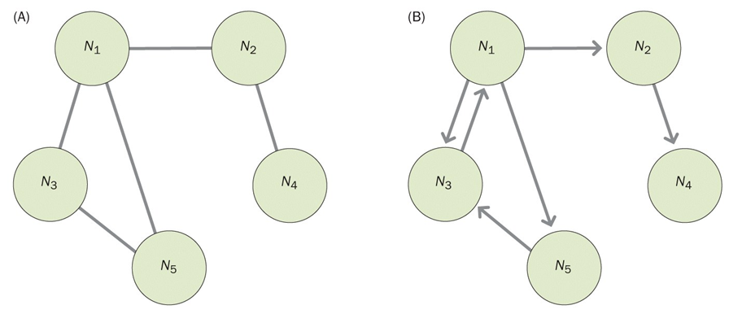

Slide 5
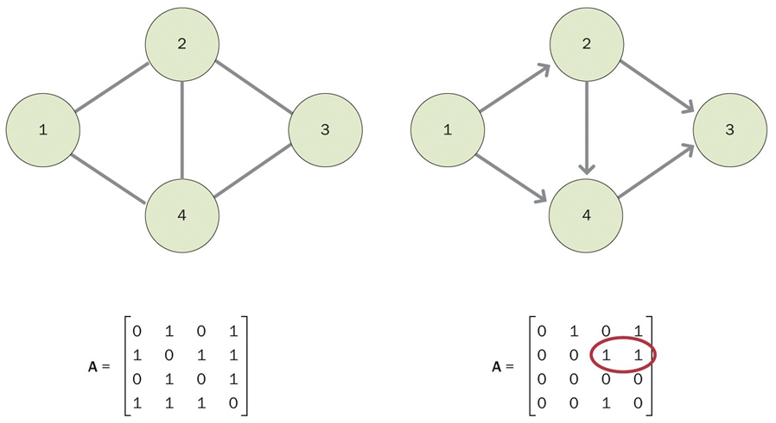

Slide 6
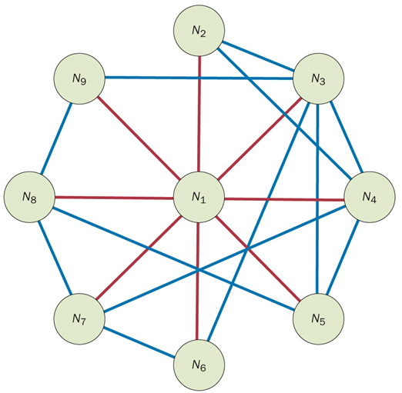
Clustering coefficient: Characterizing density of edges associated with a node
UG: C_{N} = 2e/k(k-1)
DG: C_{N} = e/k(k-1)
(k is degree)

Slide 7
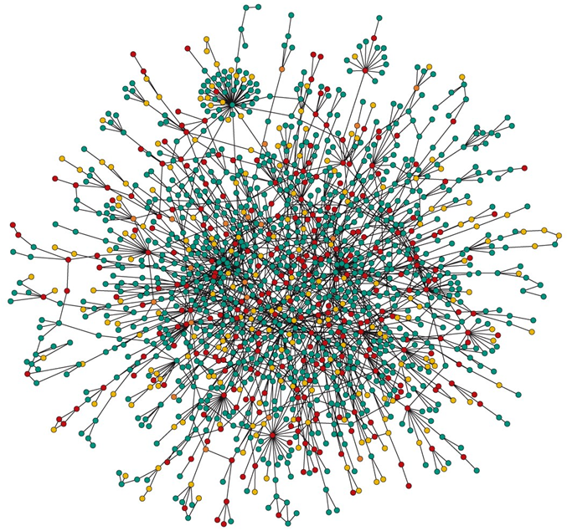

Slide 8
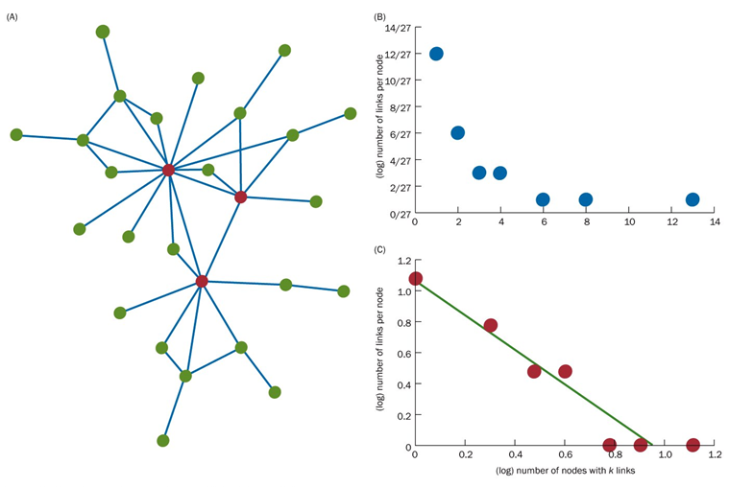
Power-law and degree distribution: P(k) ∝ k^{-γ}

Slide 9
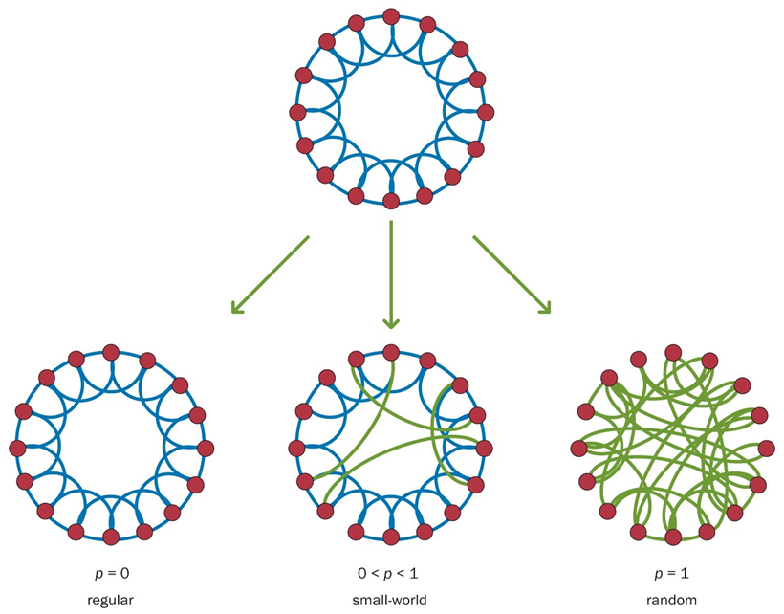

Slide 10
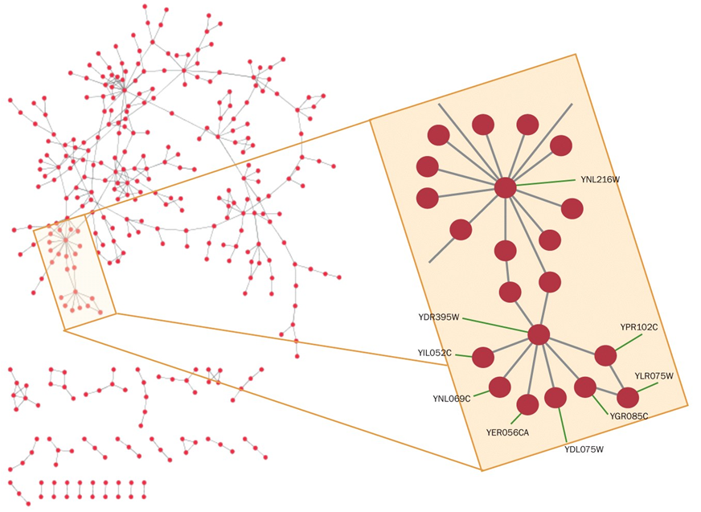

Slide 11
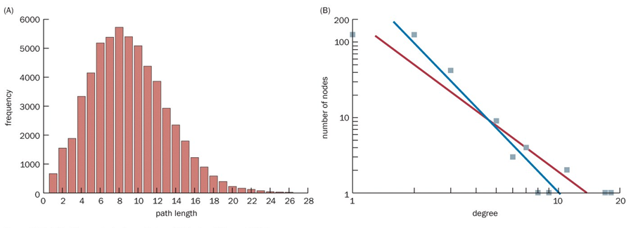

Slide 12
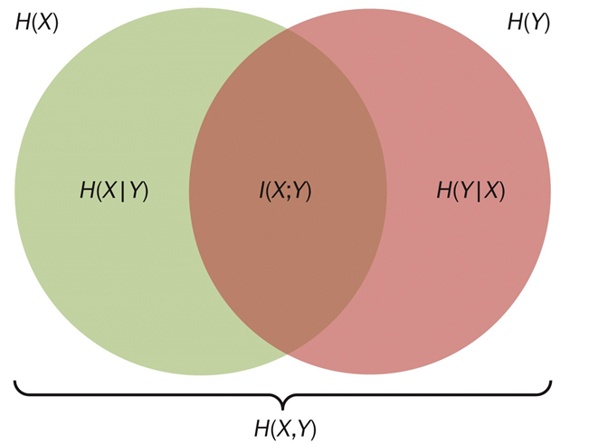
Mutual information I(X;Y) in terms of entropies H(X), H(Y) and conditional entropies H(X|Y) and H(Y|X)

Slide 13
Bayes’ theorem
(Also called Bayes’ law/formula/rule)
When prior knowledge is available, Bayes’ theorem allows computation of probability of an event.
Note: P(B) is non-zero.
Where:
P(A) and P(B) are (independent probabilities of observing events A and B,
P(A|B) is the ‘conditional probability’ (ie, prob. of observing A when B happens), and
P(B|A) is the ‘conditional probability’ (ie, prob. of observing B when A happens).

Slide 15
Prior probability: P(A), the initial belief in A
Posterior probability: P(A|B), is the probability of A given evidence B
Support B provides for A: P(B|A)/P(B)

Slide 16
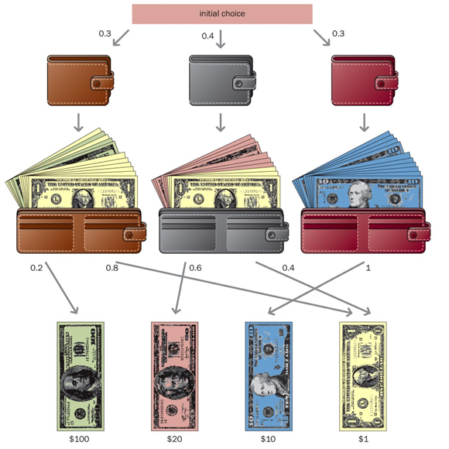
Bayesian reconstruction of interaction networks
Probabilities:
P($100) = 0.06
P($20) = 0.24
P($10) = 0.3
P($1) = 0.4

Slide 17
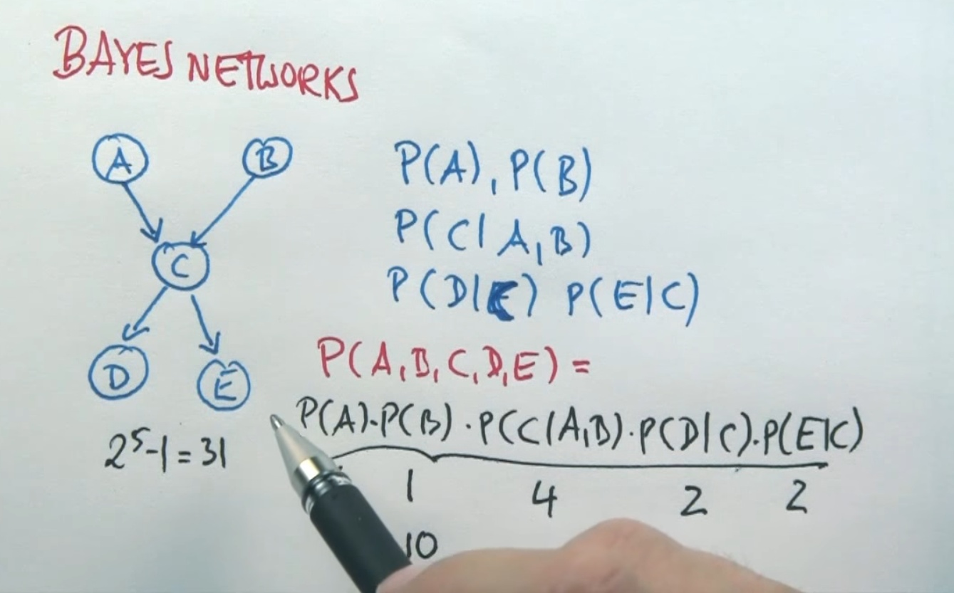

Slide 18
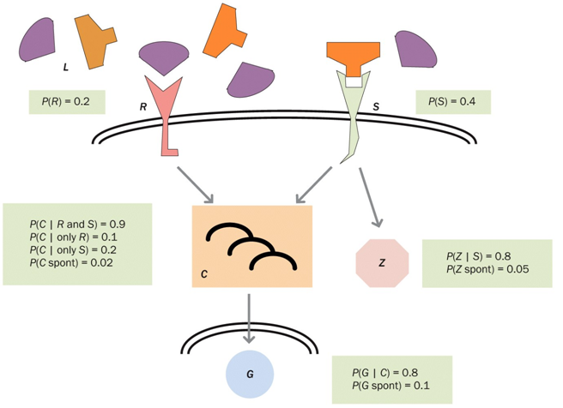
Signaling networks
Note:
In general, Bayesian network is formulated as a directed acyclic graph (DAG)

Slide 19
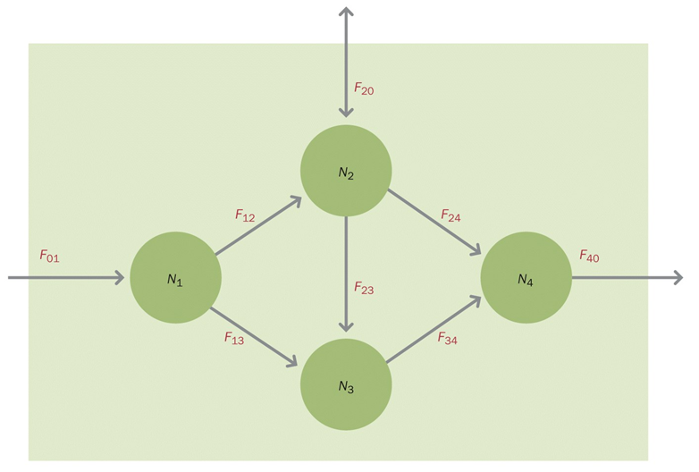
Stoichiometric networks

Slide 20
Stochiometric Analysis:
Flux Balance Analysis is widely used with biologically motivated constraints using constrained optimization.
N: Stochiometric matrix of generic flux matrix
R: Fluxes between pools

Slide 21
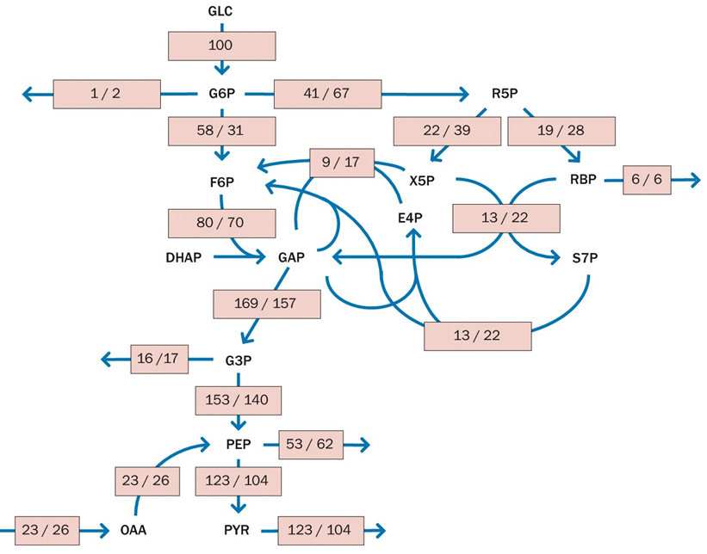

Slide 23
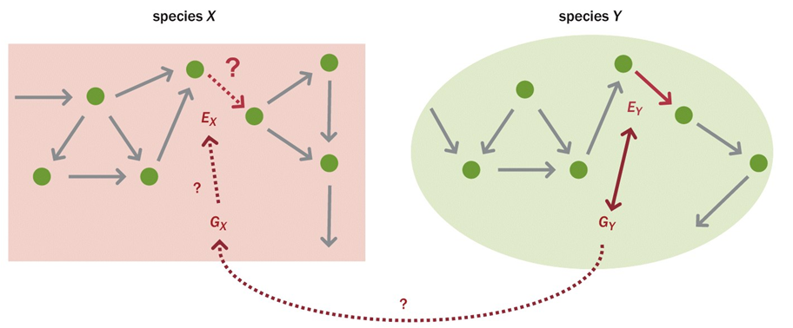
Metabolic network reconstruction
Note:
KEGG and MetaCyc databses are useful

Slide 24
Metabolic Control Analysis
Characterizes small perturbations in a metabolic pathway that operates at steady state.
It uses:
Elasticities
Control coefficients
Pathway flux
Concentration
Note: Flux control coefficients sum to 1 and concentration control coefficients sum to 0.

