Slide 1
Eberhard O. Voit
A First Course in
Systems Biology
Chapter 1
Biological Systems

Slide 2
Systems Biology: Definition
  Systems biology is the research endeavor that provides the scientific foundation for successful synthetic biology. It is based on the comprehensive study of the molecular diversity of living systems, both natural and synthetic, the identification of simplifying general principles and patterns that are recurring features in living and engineered systems, and the integration of our biological knowledge in complex models of the regulatory networks that characterize life.
    Boogerd F. C., Bruggeman F. J., Hofmeyr J.-H. S., Westerhoff H. V. “Towards philosophical foundations of Systems Biology: introduction”, Systems Biology: Philosophical Foundations

Slide 3
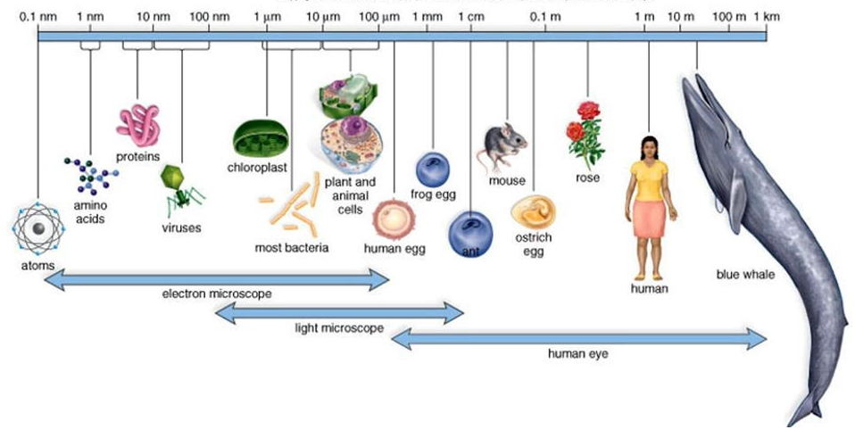
Sizes of living things (logarithmic scale)

Slide 4

Sizes of living things (logarithmic scale)

Slide 5
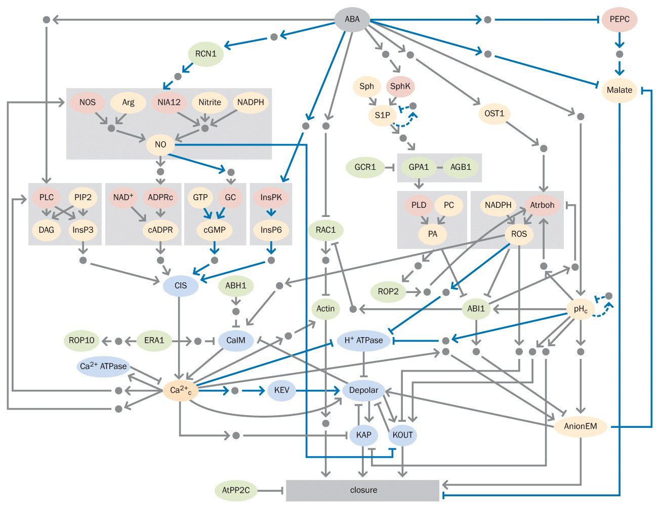
Complicated response to drought in plants

Slide 6
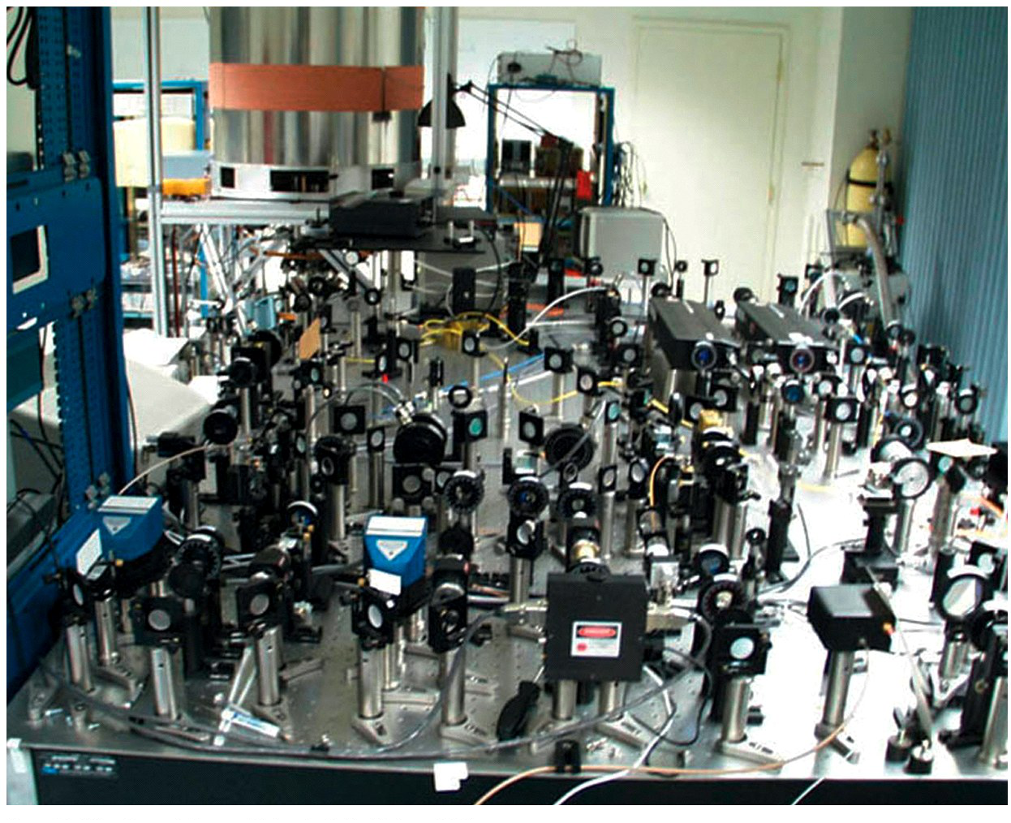
Why is it difficult to understand?
We understand what we design, even if they are complicated
Living things are very complicated and we do not understand the design
Even bacteria are very complicated!

Slide 7
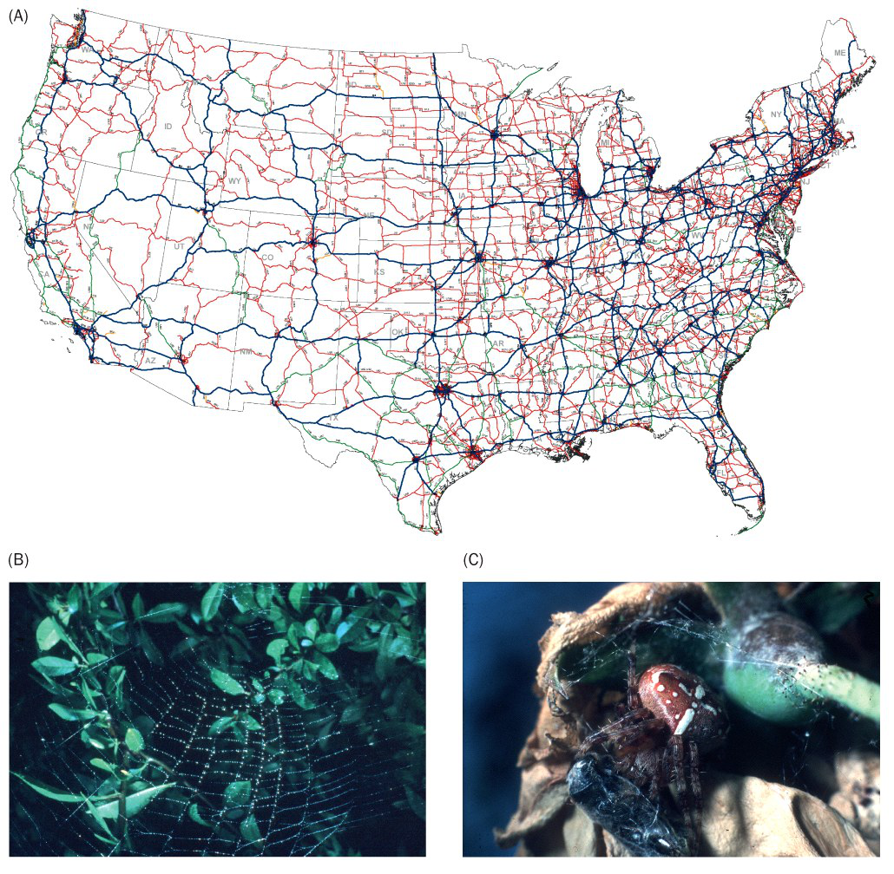
Why is it difficult to understand?
Size of problems, such as network size, does not necessarily reflect the complexity.

Slide 8
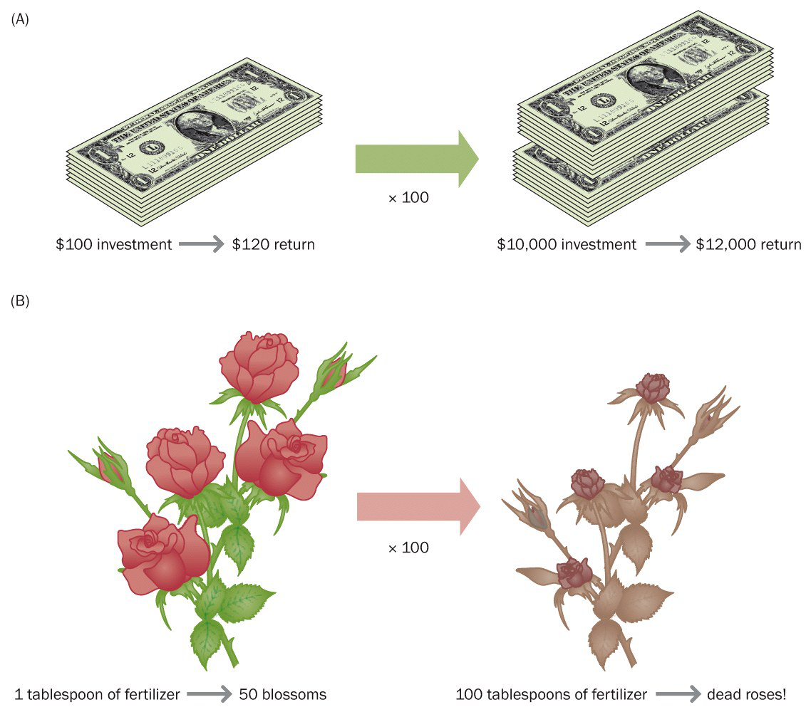
Why is it difficult to understand?
Size of problems, such as network size, does not necessarily reflect the complexity.
Common understanding/ intuition does not work for biological processes. These are not linear.

Slide 9
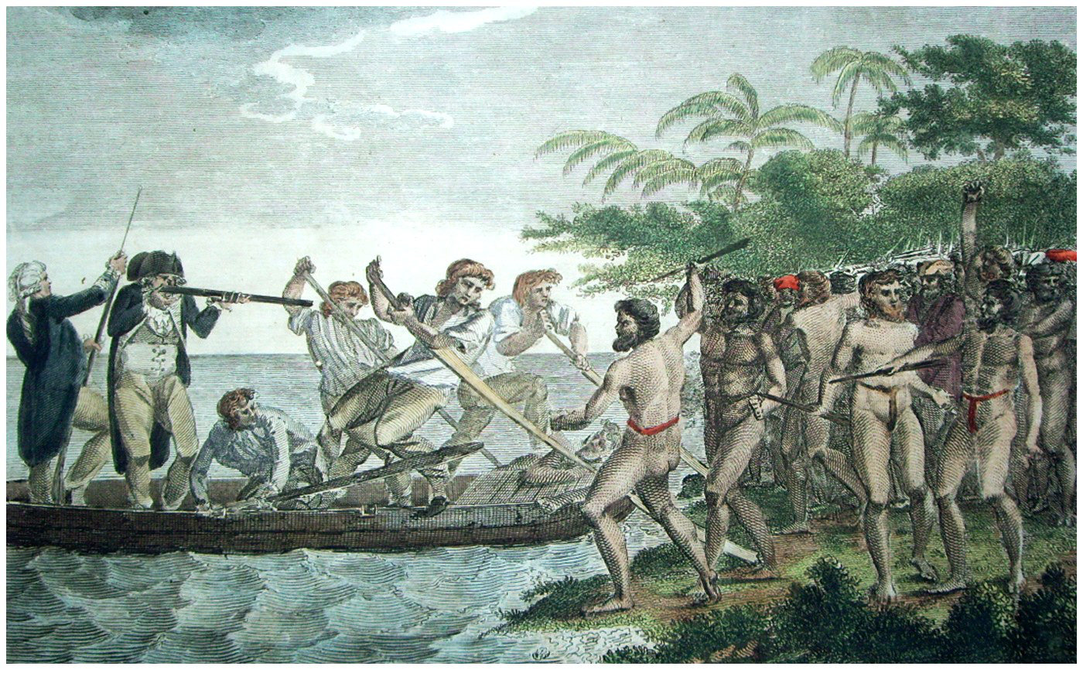
Reductionism vs Systems Biology
Collect information to understand individual components

Slide 10
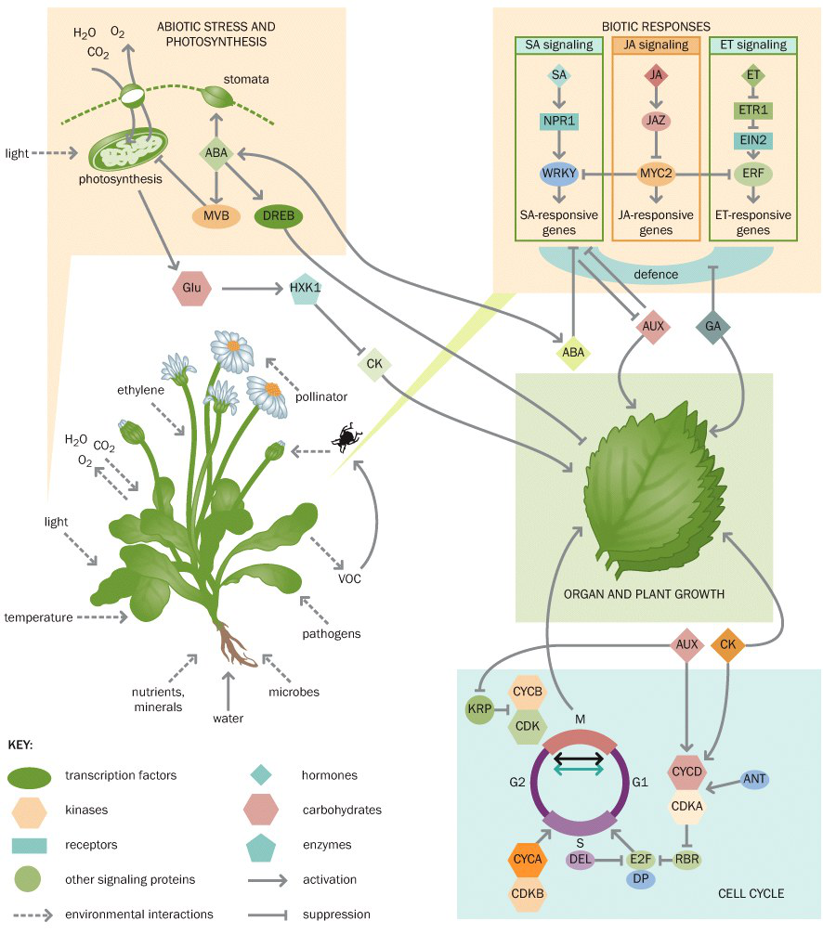
Reductionism vs Systems Biology
Collect information to understand individual components
Put them together to understand!

Slide 11
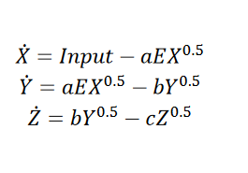
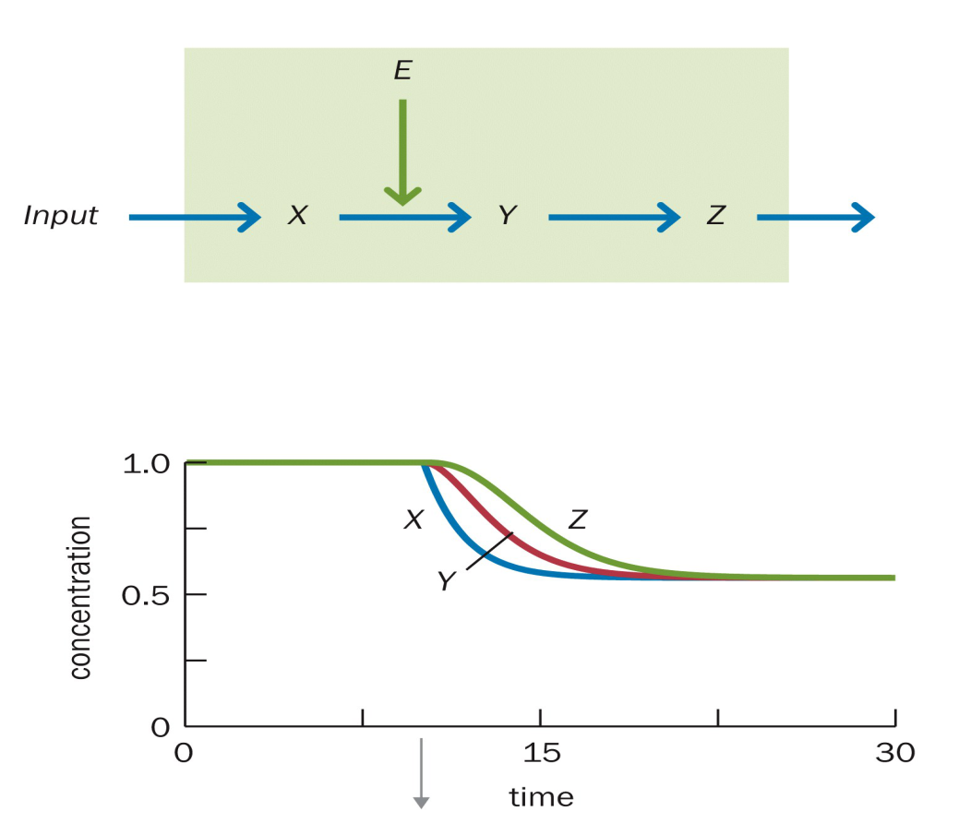
Reductionism vs Systems Biology
Collect information to understand individual components
Put them together to understand!
This is incredibly difficult even for 'simple' biological systems.

Slide 12
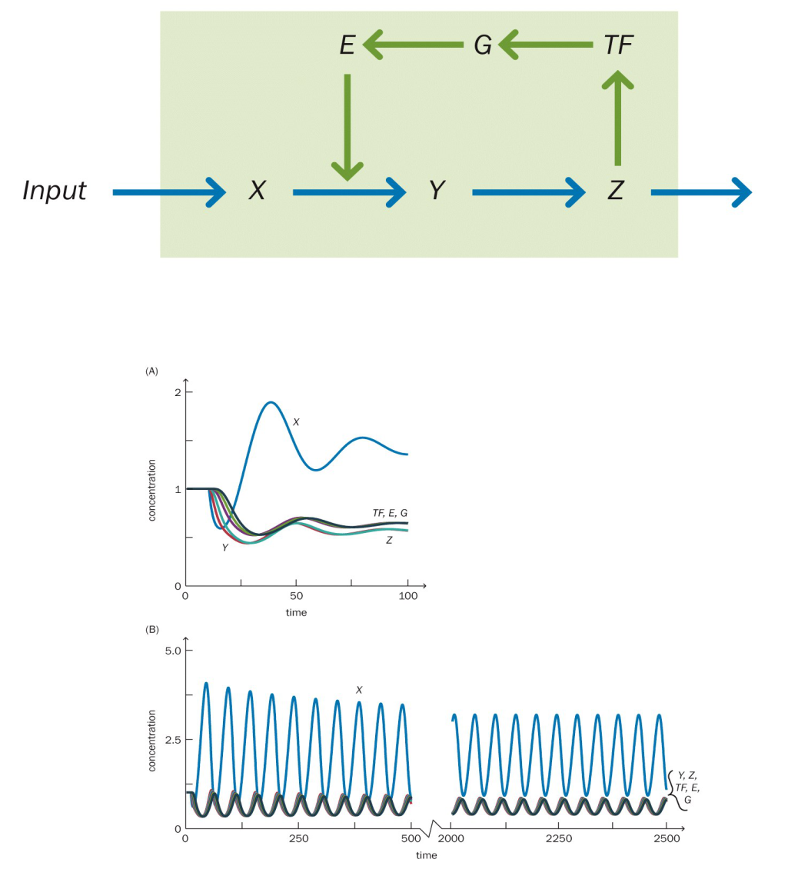
Reductionism vs Systems Biology
Collect information to understand individual components
Put them together to understand!
This is incredibly difficult even for 'simple' biological systems.

Slide 13
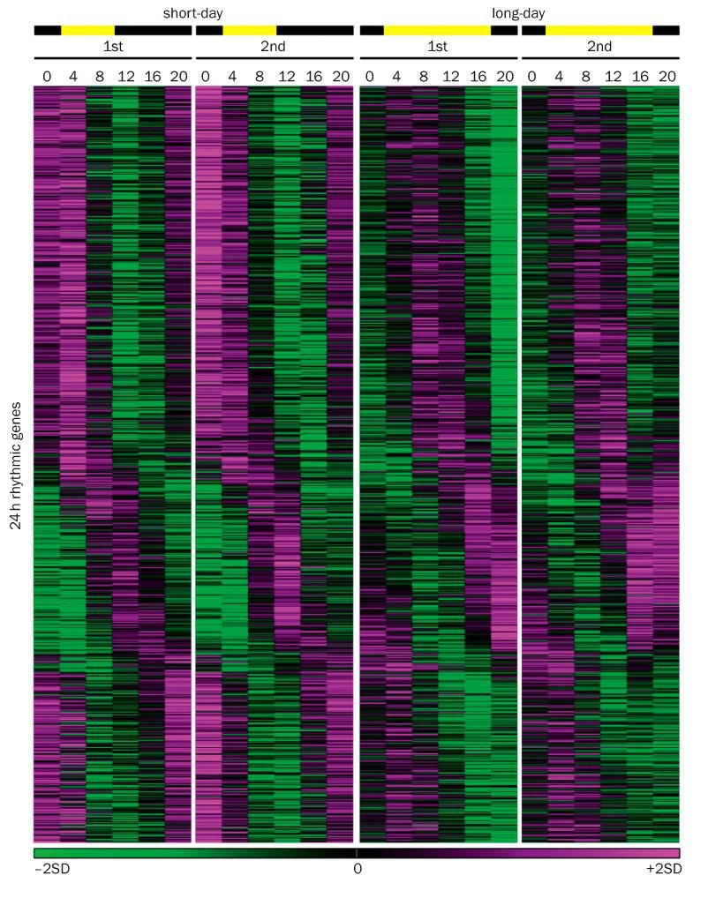
Systems Biology: Why now?
Incredible advances and information is available
  Availablity of detailed biological information

Slide 14
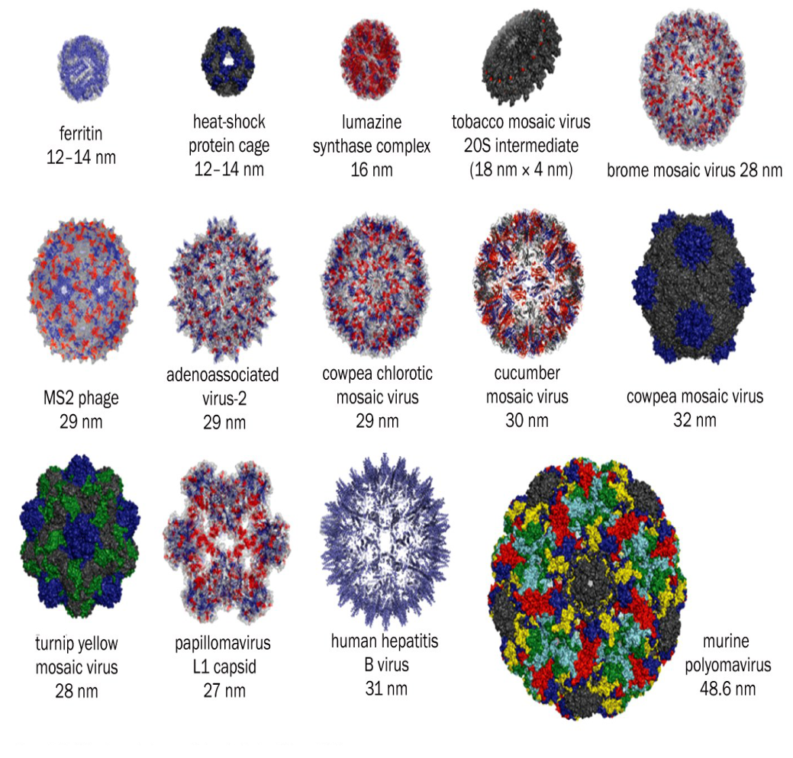
Systems Biology: Why now?
Incredible advances and information is available
  Availablity of detailed biological information
  Availability of sophisticated tools to study in vivo

Slide 15
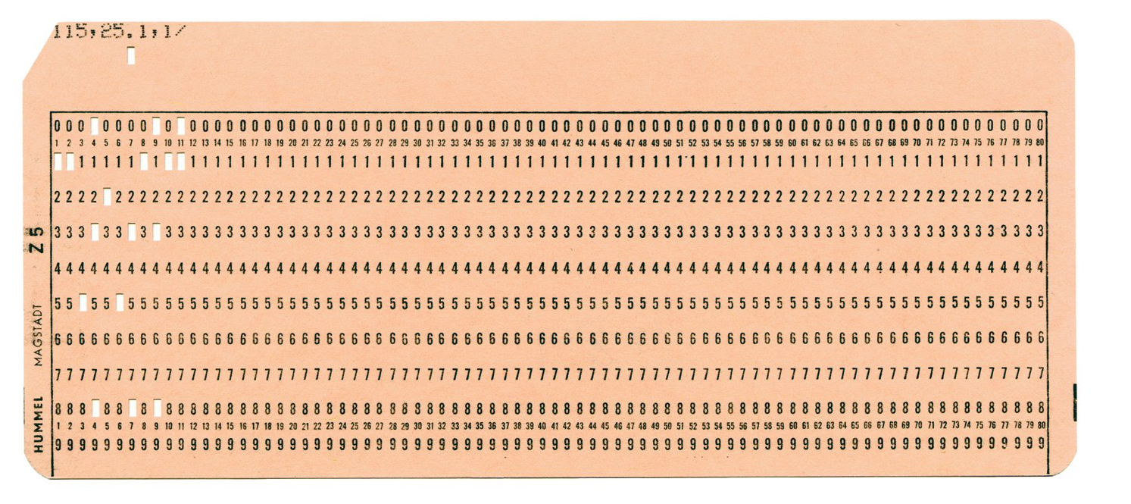
Systems Biology: Why now?
Incredible advances and information is available
  Availablity of detailed biological information
  Availability of sophisticated tools to study in vivo
  Co-evolution of mathematical, physical and computational techniques

Slide 16
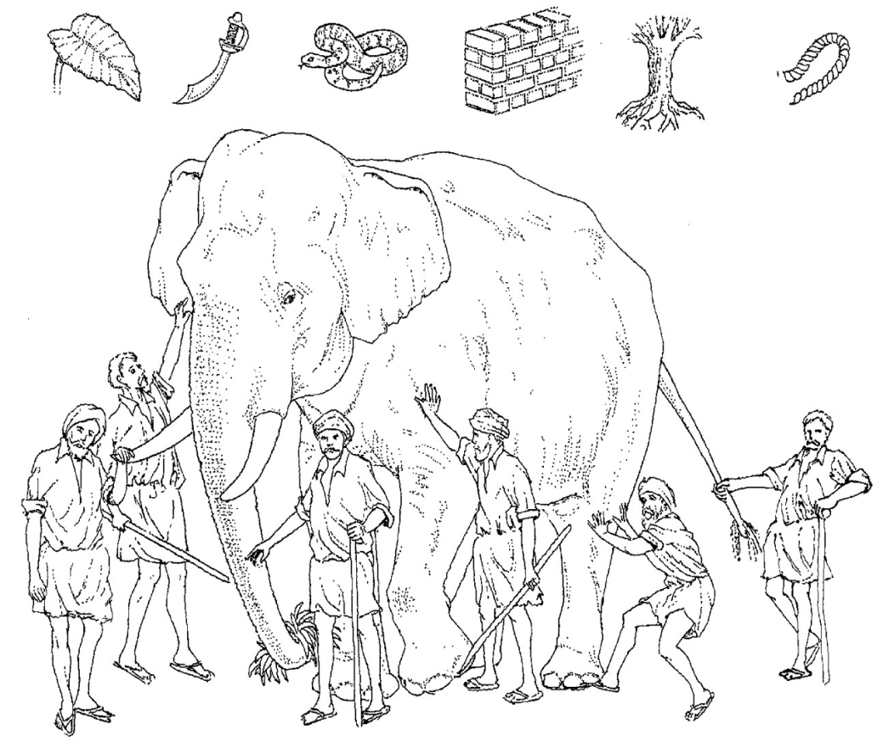
Systems Biology: Why now?
Incredible advances and information is available
Requires expertise from different fields

