Slide 1
Knuth-Morris-Pratt (KMP)
Algorithm

Slide 2
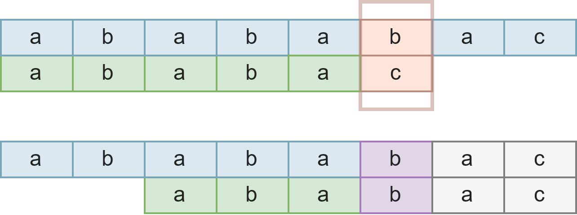
Concepts
String: ABCDE
Proper prefixes: <NULL>, A, AB, ABC, ABCD
Proper suffixes: <NULL>, E, DE, CDE, BCDE
Substring of interest: Largest common substring that is both prefix & suffix
Failure function: The length of the longest prefix of P that is a suffix of P[1..j] and f(O) = O
Intent: Upon mismatch, shift the string so that prefix replaces suffix

Slide 3
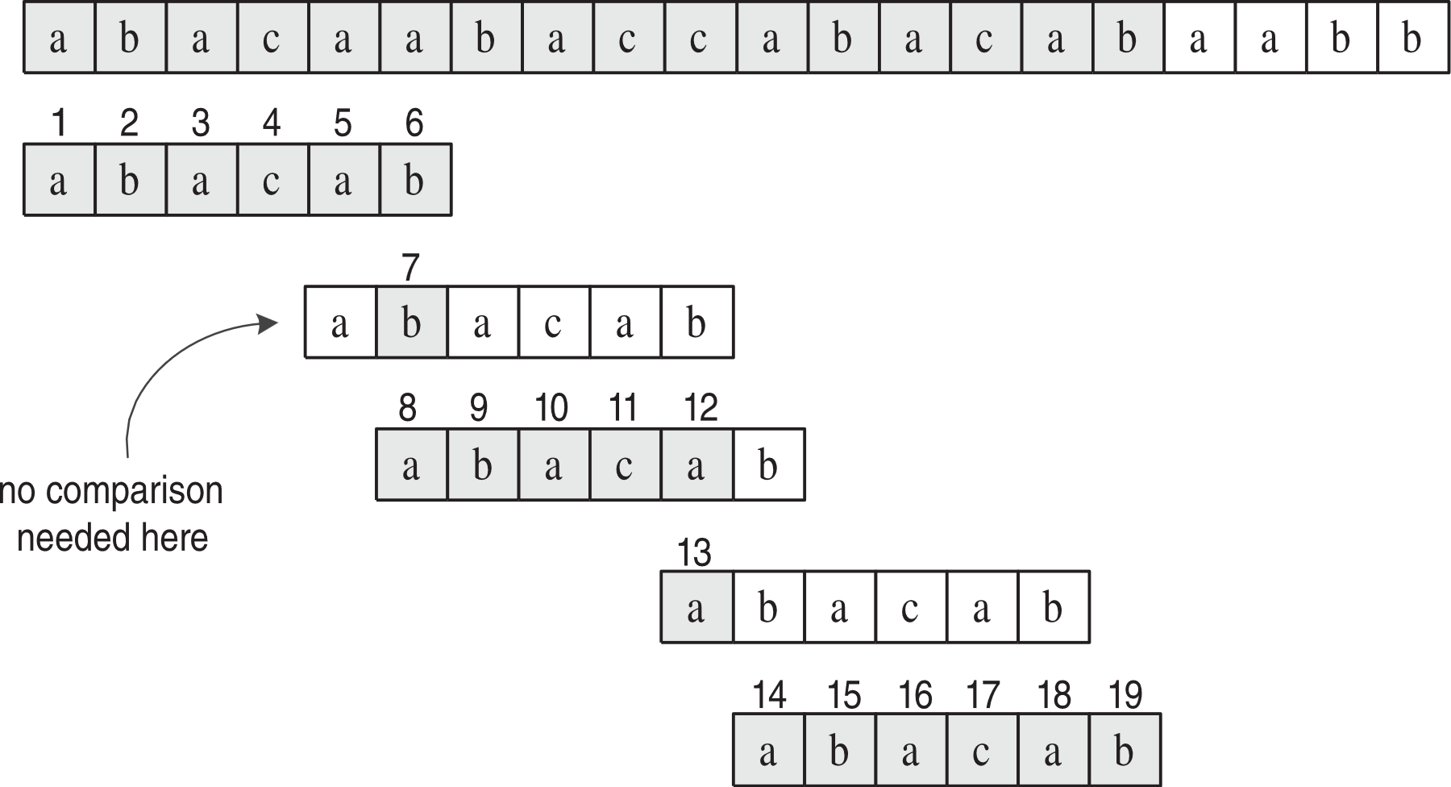
Working example of KMP search using failure function
j | 0 1 2 3 4 5
pat[j] | a b a c a b
f(j) | 0 0 1 0 1 2

Slide 4
Another example of KMP search
j | 0 1 2 3 4 5 6
pat[j] | A B C D A B D
f(j) | 0 0 0 0 1 2 0
Reference: https://blog.devgenius.io/string-matching-kmp-ccad1ffbeb11

Slide 5
Complexities?

