Slide 1
Boyer Moore Algorithm
for
Pattern Searching

Slide 2
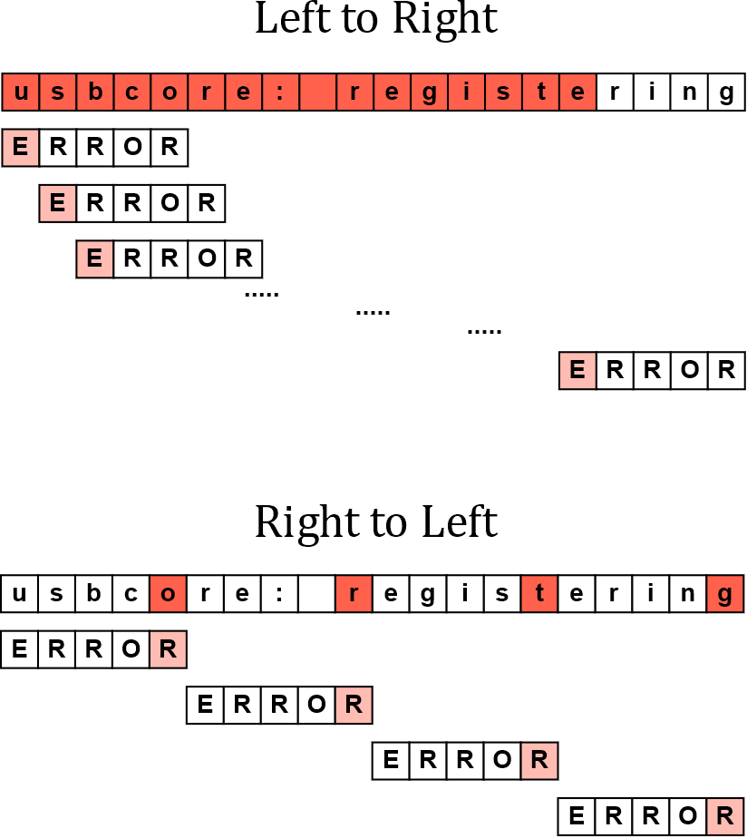

Slide 3
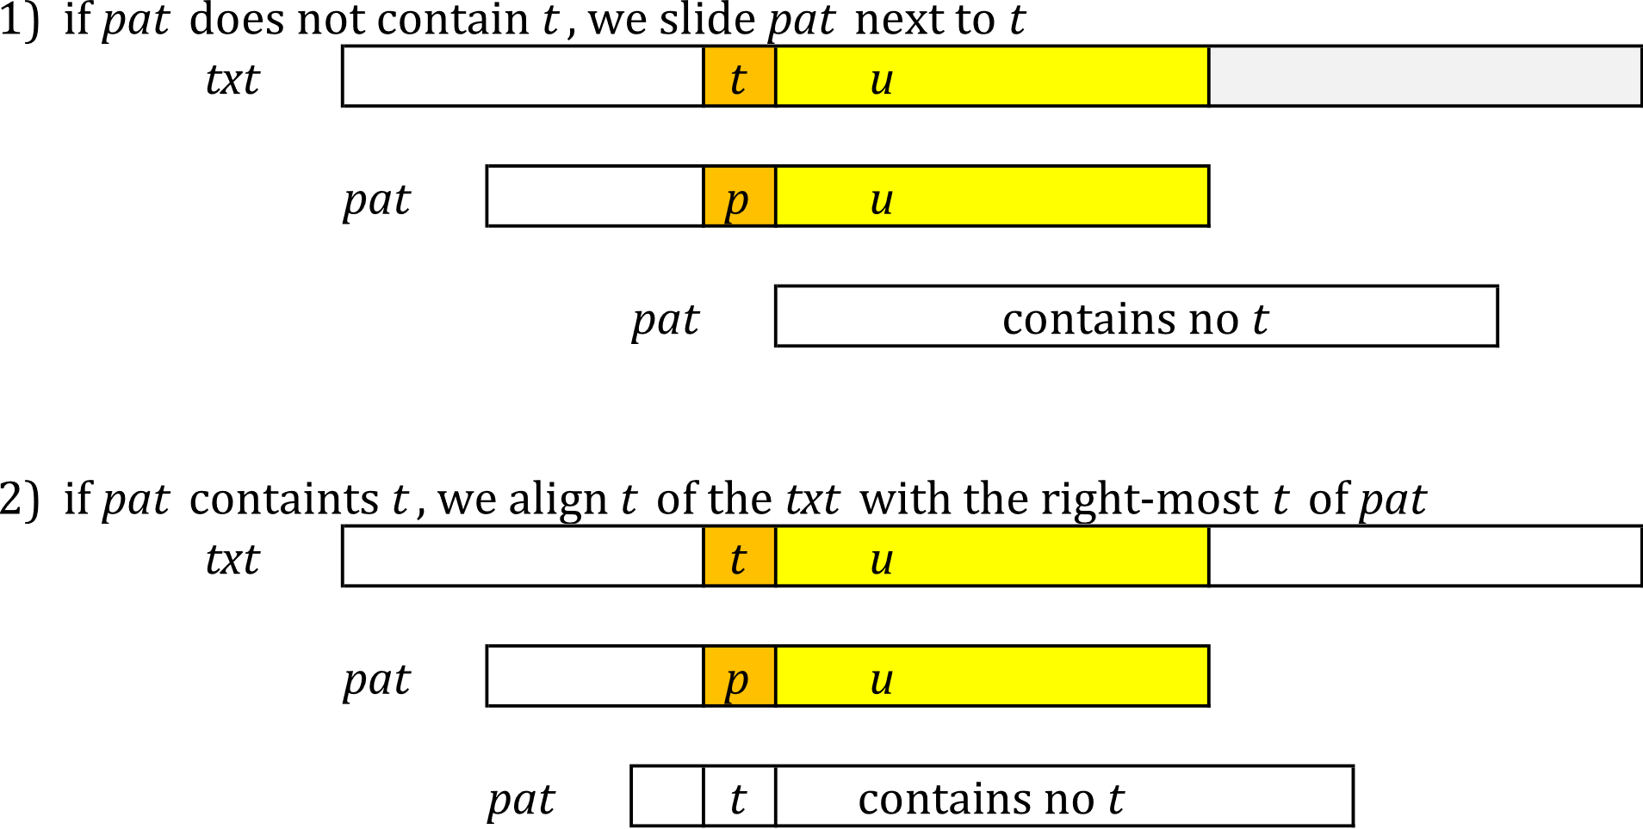
Bad character shift:

Slide 4
Bad character table:
Initialize all characters with shift of m (=length of pattern)
Moving from right-to-left, update shifts of all but last character with the number of jumps required to reach the right-most character.
If t is the character in txt that mismatched with the corresponding character of pat, d₁ is computed as following:
d₁ = bmBc(t) - k, where k is the number of characters already matched.
Example:
pat = ABACAB
c | A | B | C | *
bmBc(c) | 1 | 4 | 2 | 6

Slide 5
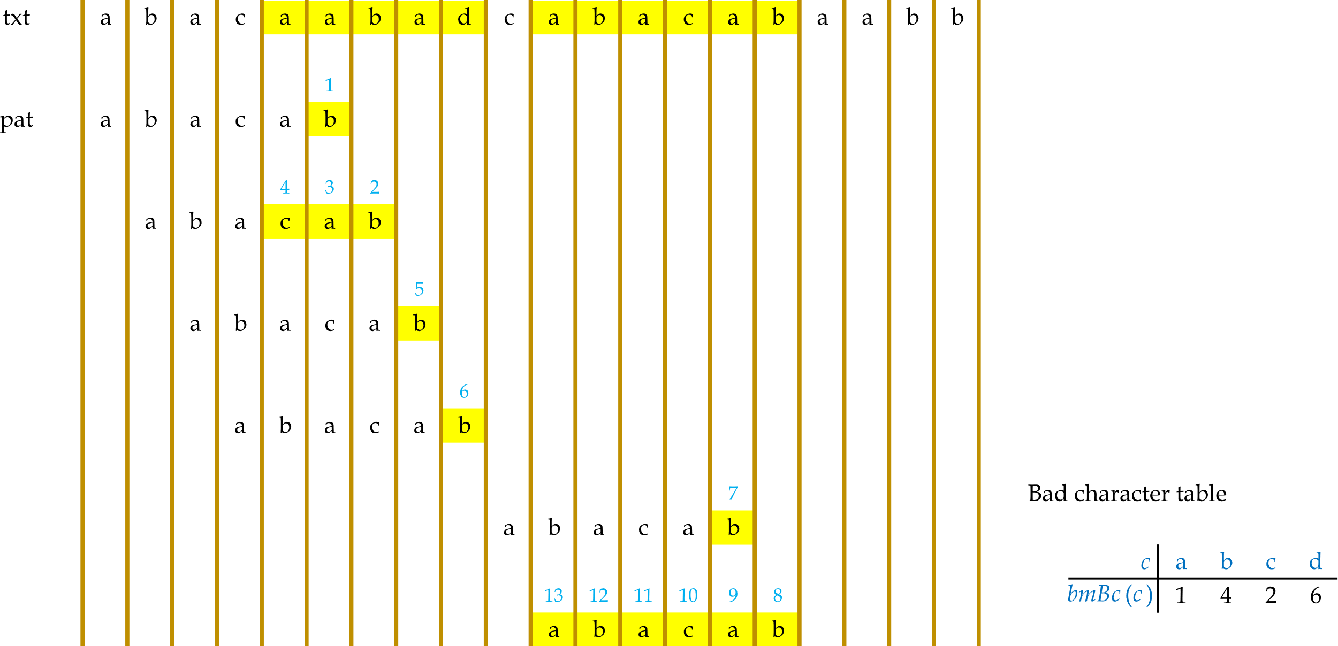
Bad character table:

Slide 6
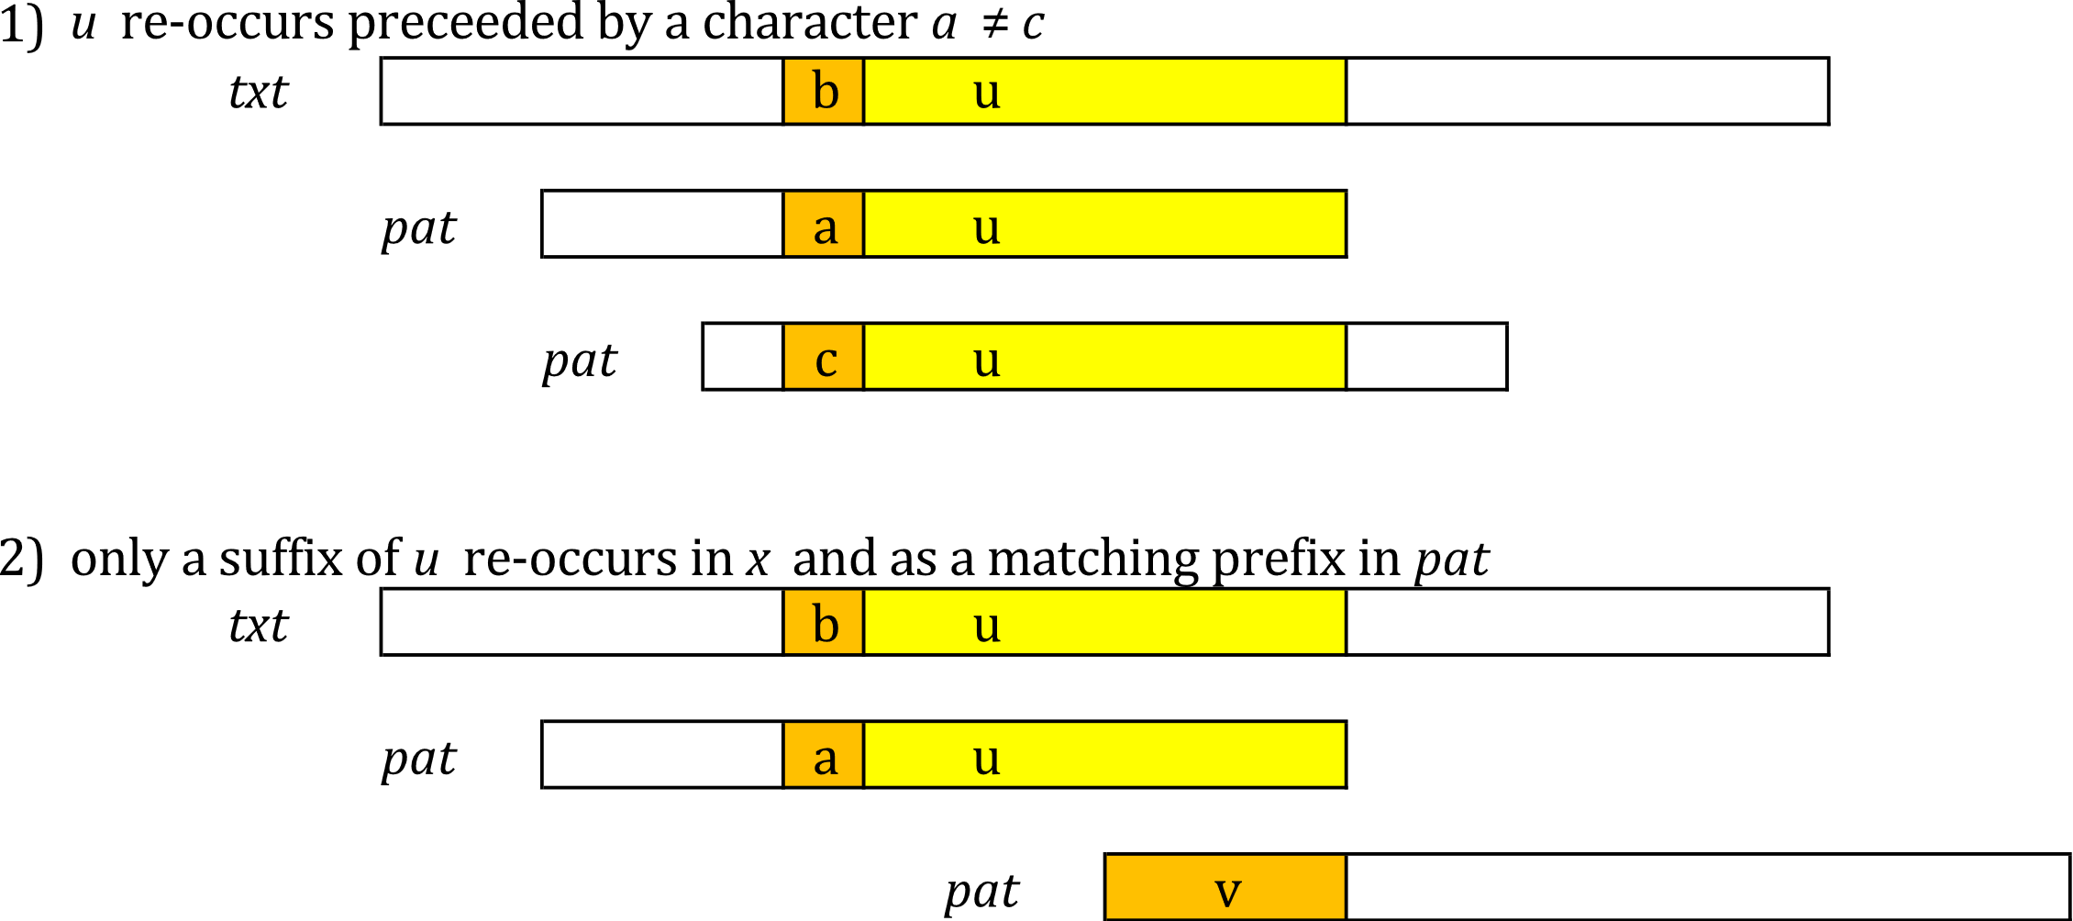
Good suffix shift:

Slide 7
Good suffix table:
k | Pattern | d₂ | Requirement
1 | $\overline{G}$ C A G A G A G | 7 | G not preceded by A
2 | G C $\overline{A G}$ A G A G | 4 | AG not preceded by G
3 | $\overline{G}$ C A G A G A G | 7 | GAG not preceded by A
4 | G C $\overline{A G A G}$ A G | 2 | AGAG not preceded by G
5 | $\overline{G}$ C A G A G A G | 7 | GAGAG not preceded by A
6 | $\overline{G}$ C A G A G A G | 7 | AGAGAG not preceded by C
7 | $\overline{G}$ C A G A G A G | 7 | CAGAGAG not preceded by G

Slide 8
Good suffix table:
k | Pattern | d₂
1 | A B C $\overline{B}$ A B | 2
2 | $\overline{A B}$C B A B | 4
3 | $\overline{A B}$C B A B | 4
4 | $\overline{A B}$ C B A B | 4
5 | $\overline{A B}$ C B A B | 4
k | Pattern | d₂
1 | B A O $\overline{B}$ A B | 2
2 | $\overline{B}$ A O B A B | 5
3 | $\overline{B}$ A O B A B | 5
4 | $\overline{B}$ A O B A B | 5
5 | $\overline{B}$ A O B A B | 5

Slide 9
Good suffix table:
Not optimal as a = c (= I)
k | Pattern | d₂
1 | A J $\overline{I}$ J I | 2
2 | A $\overline{J I}$ J I | 2
3 | A J I J I | 5
4 | A J I J I | 5
k | Pattern | d₂
1 | D R $\overline{I}$ D I | 2
2 | D R I D I | 5
3 | D R I D I | 5
4 | D R I D I | 5
k | Pattern | d₂
1 | S T O R | 4
2 | S T O R | 4
3 | S T O R | 4

Slide 10
Good suffix table:
k | Pattern | d₂ | Requirement
1 | $\overline{G}$ C A G A G A G | 7 | G not preceded by A
2 | G C $\overline{A G}$ A G A G | 4 | AG not preceded by G
3 | $\overline{G}$ C A G A G A G | 7 | GAG not preceded by A
4 | G C $\overline{A G A G}$ A G | 2 | AGAG not preceded by G
5 | $\overline{G}$ C A G A G A G | 7 | GAGAG not preceded by A
6 | $\overline{G}$ C A G A G A G | 7 | AGAGAG not preceded by C
7 | $\overline{G}$ C A G A G A G | 7 | CAGAGAG not preceded by G

Slide 11
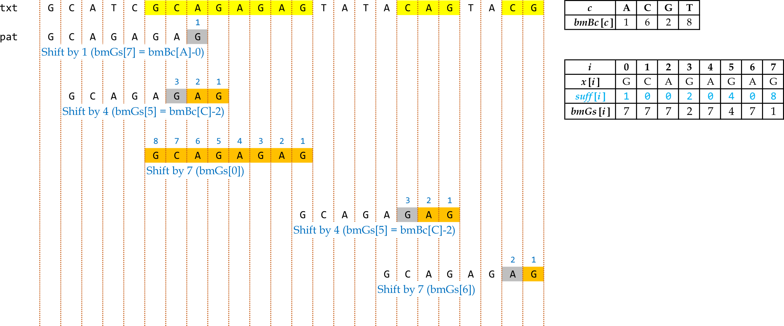
Complete example
Shift k = max{d₁, d₂}

Slide 12
c | B | A | O | *
bmBc(c) | 1 | 4 | 3 | 6
k | Pattern | d₂
1 | B A O $\overline{B}$ A B | 2
2 | $\overline{B}$ A O B A B | 5
3 | $\overline{B}$ A O B A B | 5
4 | $\overline{B}$ A O B A B | 5
5 | $\overline{B}$ A O B A B | 5
d₁ = bmBc(t) – k
d = max{d₁ , d₂}
See: https://www.youtube.com/watch?v=JITD8C2wLQY

Slide 13
Complexities?

